Slide 1

UI-Projekt
Christian Walmar
Emma Rebner
Vitaliy Serdyukov
Younes Elhamss

Slide 2

Preview:

Slide 3
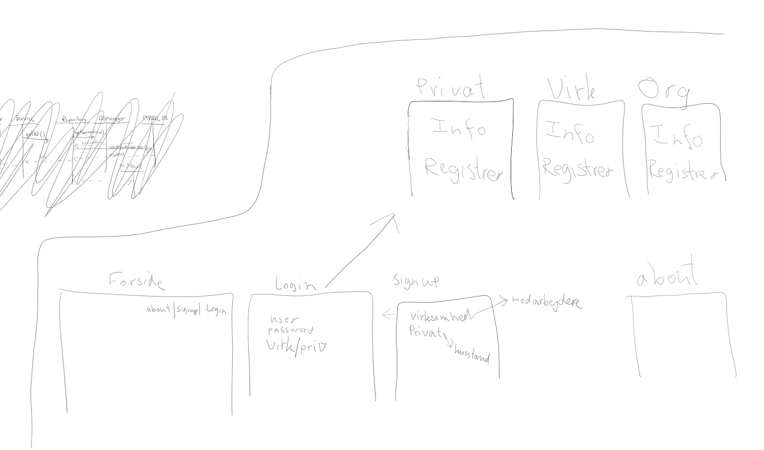
Prototype(skitse)

Slide 4
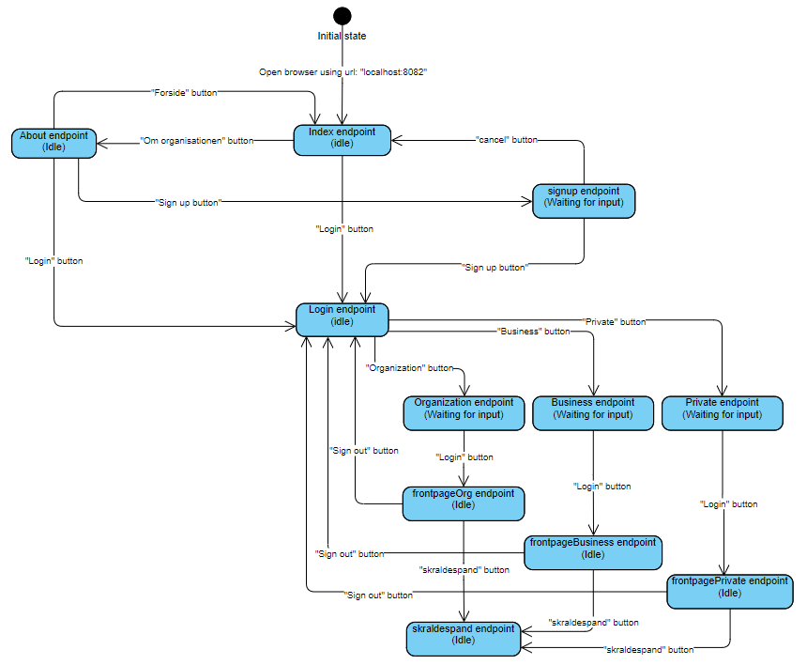
State Machine Diagram

Slide 5
Principper og værktøjer 10 Usability Heuristics:
#1: Visibility of system status: - ”Login” knap, ”Sign up” knap
#2: Match between system and the real world: - ”Garbage Can”,
#3: User control and freedom: - ”Cancel” knap, navigation bar
#4: Consistency and standards: - Farver, navigation bar, skrifttype,
header, industry standards: forside i
starten, navigation bar
#5: Error prevention: - ”Submit” knap når man er færdig,
cancel knap hvis man vil tilbage
#6: Recognition rather than recall: - Navigation bar og h1 gør det let at
forstå og huske hvor man er
#7: Flexibility and efficiency of use: - Manglende (prototype)
#8: Aesthetic and minimalistic design: - Få farver, header og logo viser det
klare mål
#9: Help users recognize, dagnose and recover
from errors: - Ingen error messages (prototype)
#10 Help and documentation: - Ingen hjælp eller dokumentation

Slide 6
User Persona
Virksomheder
Organisationer
Private

Slide 7
Kvalitetssikring
UX Research Techniques: - The expert review
Testing Techniques: - Think aloud testing

